Slide 1
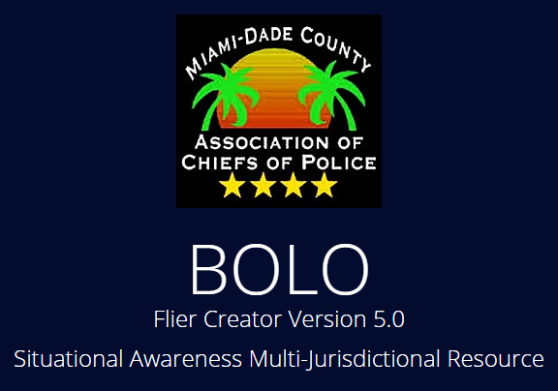
BOLO 5
Team Member(s): Nilton Munoz, Emmanuel Gonzalez, Jorge Medina, John Burke Product Owner(s): Samuel Ceballos, Jason Cohen
Mentor(s): Juan Caraballo, Robert Loredo
Instructors: Masoud Sadjadi, Mohsen Taheri
School of Computing and Information Sciences Florida International University
Senior Project Final Presentation
<Summer 2016>
August 5th, 2016
Notes:
7 seconds.
Greet your audience, thank them for attending your presentation, introduce yourself, introduce your project, introduce your team members, and quickly indicate what each of you did in a high-level manner, and put more emphasis on your part/contribution.

Slide 2
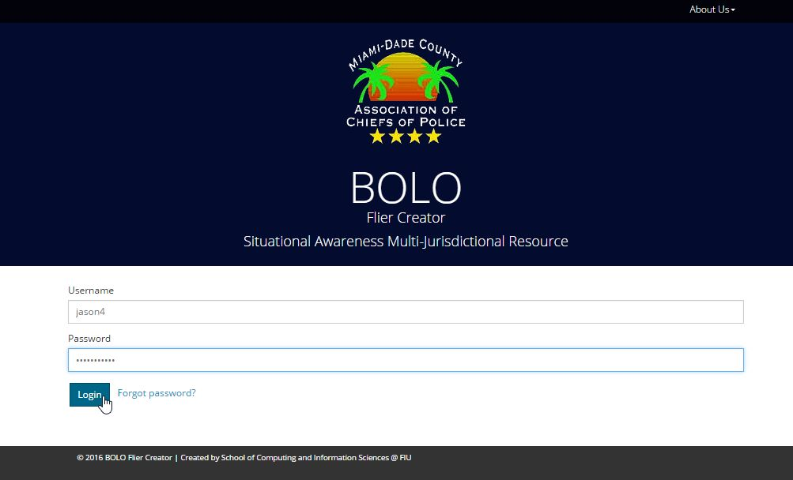
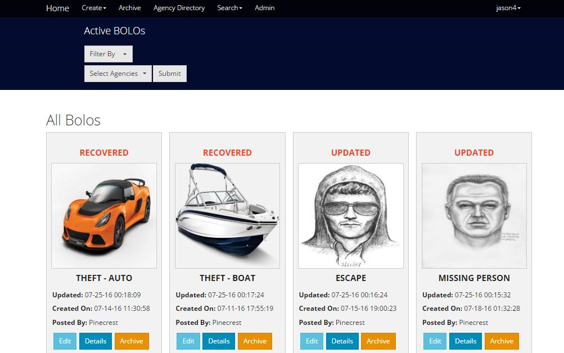
Project definition
BOLO (Be On The Lookout) Project:
Web based application which allows the creation of BOLO flyers
Distributed Instantly
Notes:
10 seconds.
Introduce the problem that the whole project (in all versions) tackles with GIF or screenshot.

Slide 3
Project definition
Bolo 5.0:
Security Enhancements:
Brute Force Prevention
SSL Enforcing
Session Timeout
BOLO confirmations
User Management (activate - deactivate users)
Output of Data:
JSON feed to third party Agencies
CSV output for statistical analysis
Previews, Details and PDF Views for templates
Retrieval Points for Data analysis
Visual Enhancements:
Redesigned navigations
Watermarks for BOLO PDfs
Custom Templates
Templates for BOLO Theft Auto and Theft Boat
New search pages for the new templates
Notes:
20 seconds.
Introduce the problem that the your project (in new version) tackles with GIF or screenshot.

Slide 4
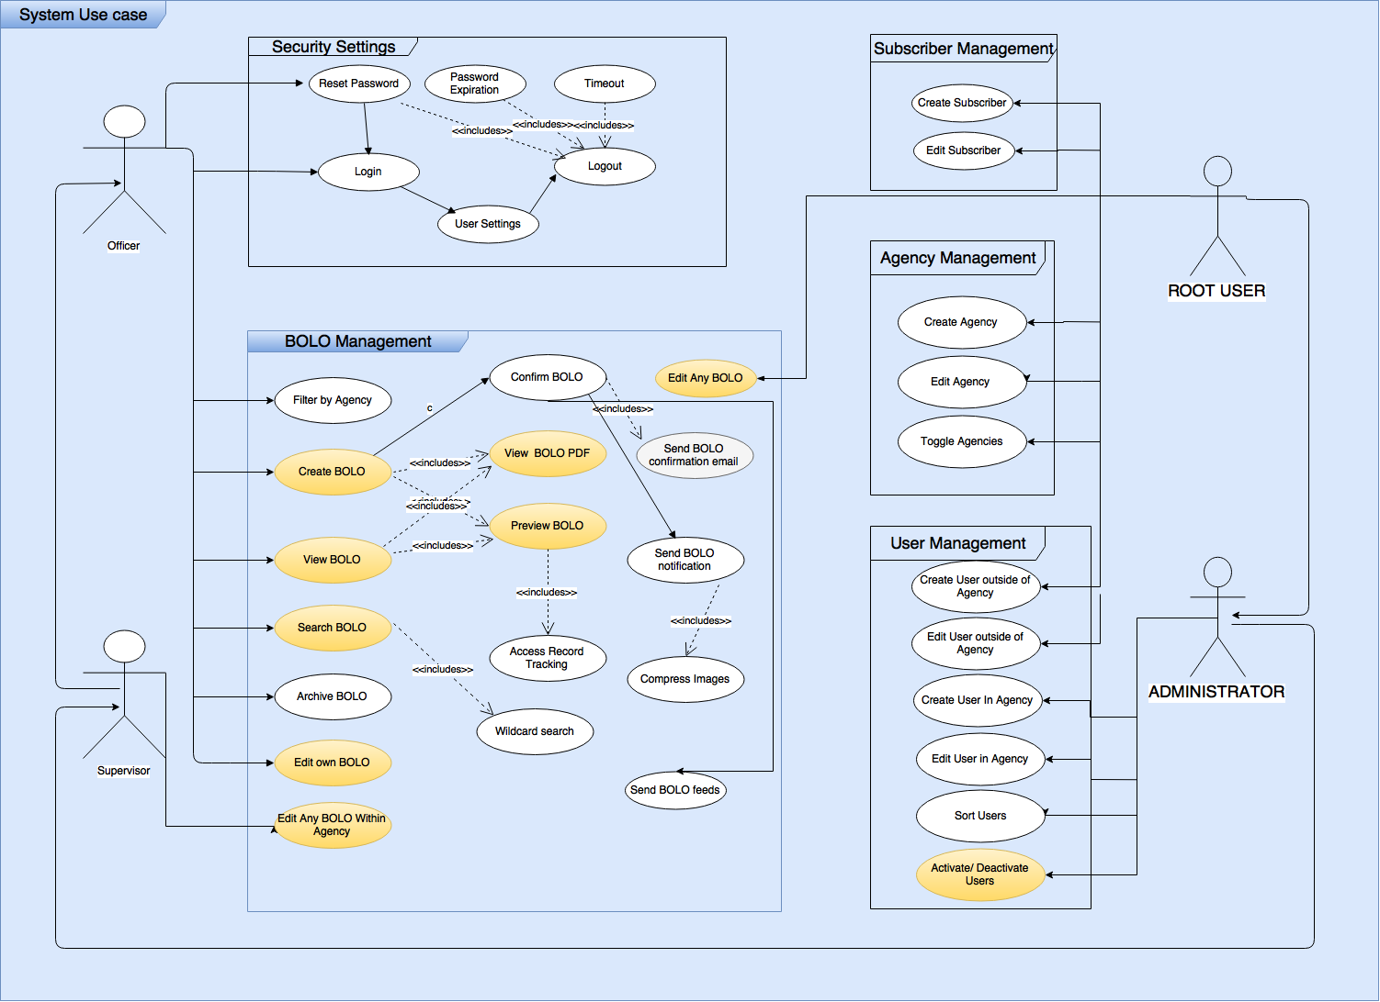
Requirements: Use Cases
Notes:
5 seconds
Show the Use Case Diagram for the whole project. Highlight your use cases.

Slide 5
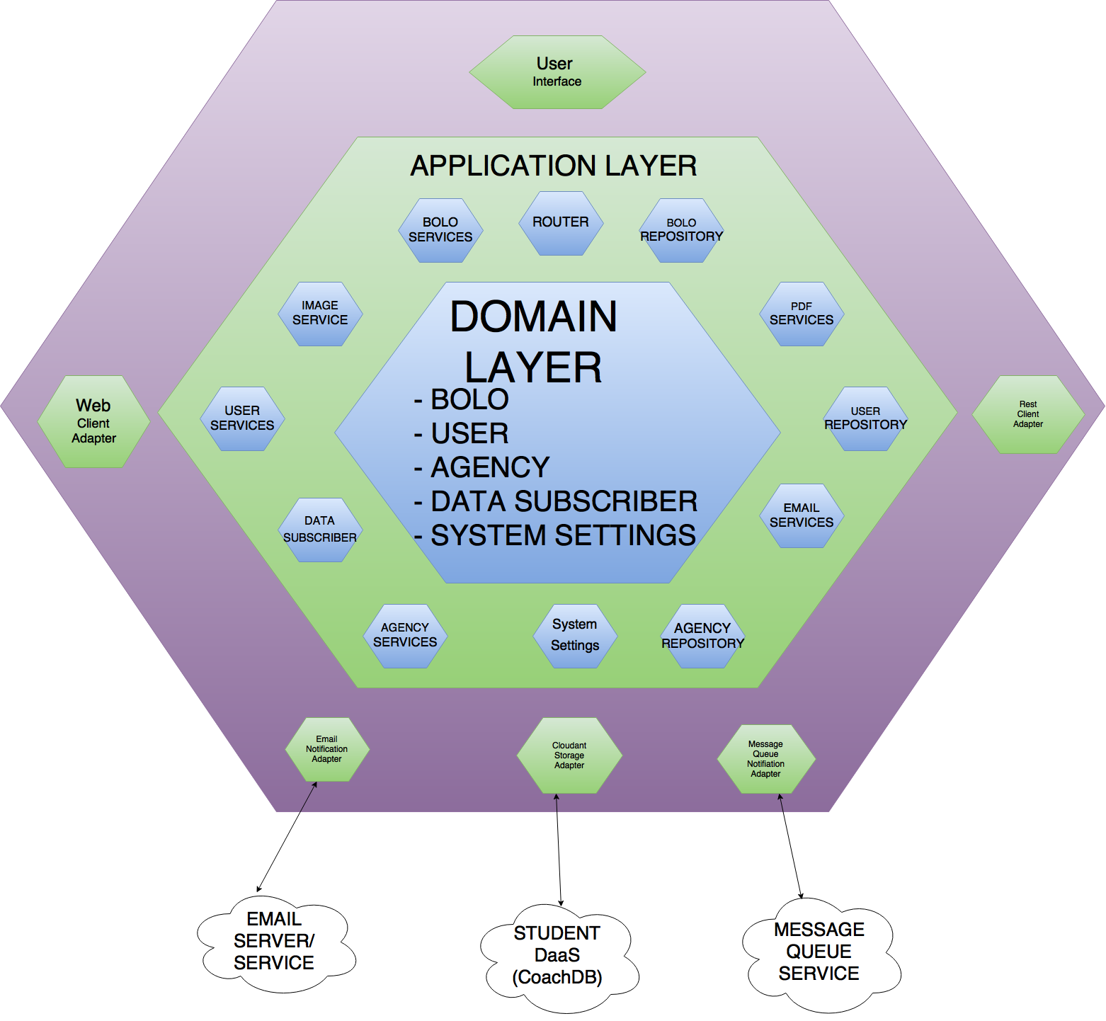
System Design: Architecture
Notes:
20 seconds
System design: Highlight the parts that you contributed to them.
1. System decomposition; identify the architecture patterns used
2. System deployment – h/w and s/w requirements

Slide 6
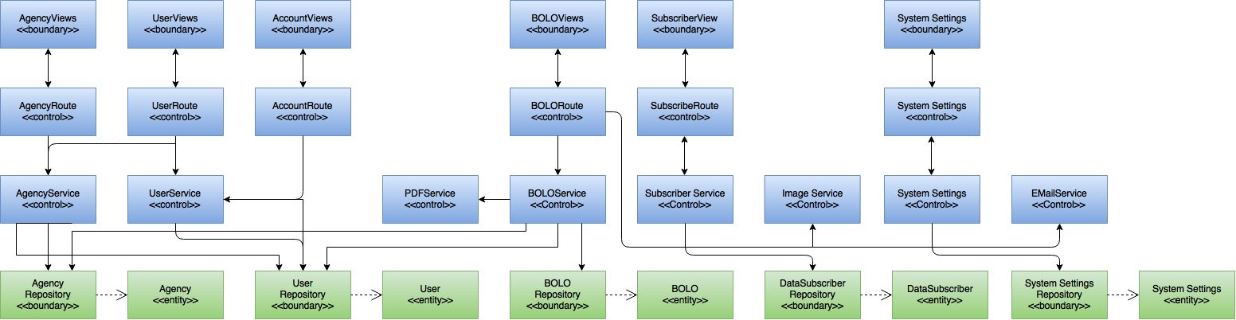
Minimal Class Diagram
Notes:
10 seconds.
Minimal class diagram. Highlight the classes that you created/modified
Identify the design patterns used (one or more slides).

Slide 7
User Stories
1.Redesign and add validations for Theft Auto Template
2.Redesign and add validations for Theft Boat Template
3.Implement Search for New Bolo Templates
4.Implement time retrieval points for data analysis for Create Bolo (General - Auto - Boat)
5.Implement time retrieval points for data analysis for Edit Bolo (General - Auto - Boat)
Notes:
5 seconds.
List the user stories that you worked on them.(put in order of importance). Stay focused on the parts that you have been working.

Slide 8
User Stories
6.Deactivate and Activate User Accounts from Root and Administrator
7.Other Features
Change interactive status menu to static
Keep data fields content after validations
Specific view only for root and administrator and a different view for user
View Bolo when it is archived and some color for buttons

Slide 9
User Story #1: Redesign and add validations for Theft Auto Template
Create new routes, attributes, connecting them to the services
Create the different views for the whole circuit (Edit, Preview, Details and PDF)
Create JQuery data fields validations
Notes:
60 seconds
The tile of user story
The most important user story you worked on it. You have to describe this one very well and be proud of that.
Please present and show the complexity of your work, code, algorithms, and technical challenges and technologies you have used. (you could use screenshot if you want. Visual presentations are better than text presentation)
Go into the details of the most important/significant tasks using bullet lists or visual graphs or state chart diagram
Sequence Diagram for this user story is mandatory (in another separate page if required)
Demo using screenshots or GIF (in another separate page if required)

Slide 10
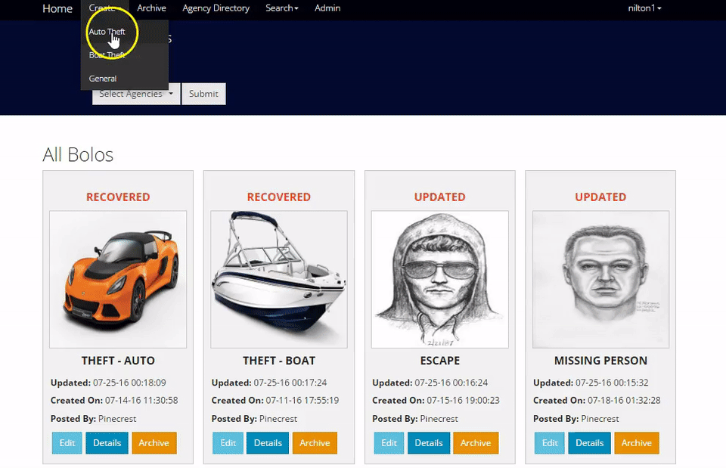

Slide 11
User Story #2: Redesign and add validations for Theft Boat Template
Create new routes, attributes, connecting them to the services
Create the different views for the whole circuit (Edit, Preview, Details and PDF)
Create JQuery data fields validations
Notes:
20 seconds
The tile of user story
Please present and show the complexity of your work, code, algorithms, and technical challenges and technologies you have used. (you could use screenshot if you want. Visual presentations are better than text presentation) - Go into the details of the most important/significant tasks using bullet lists or visual graphs or state chart diagram - Demo using screenshots or GIF (in another separate page if required)
Sequence Diagram for this user story is optional

Slide 12
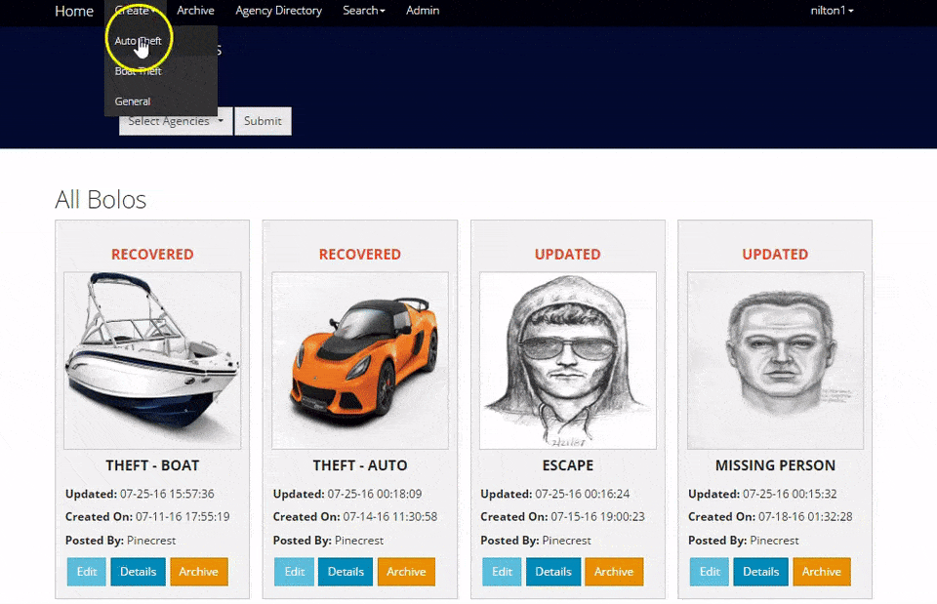

Slide 13
User Story #3: Implement Search for New Bolo Templates
Create the new search views for Bolo Theft Auto and Theft Boat
Create the new indexes in the repository
Create new routes and connect them with the service
Notes:
20 seconds
The tile of user story
Please present and show the complexity of your work, code, algorithms, and technical challenges and technologies you have used. (you could use screenshot if you want. Visual presentations are better than text presentation) - Go into the details of the most important/significant tasks using bullet lists or visual graphs or state chart diagram - Demo using screenshots or GIF (in another separate page if required)
Sequence Diagram for this user story is optional

Slide 14
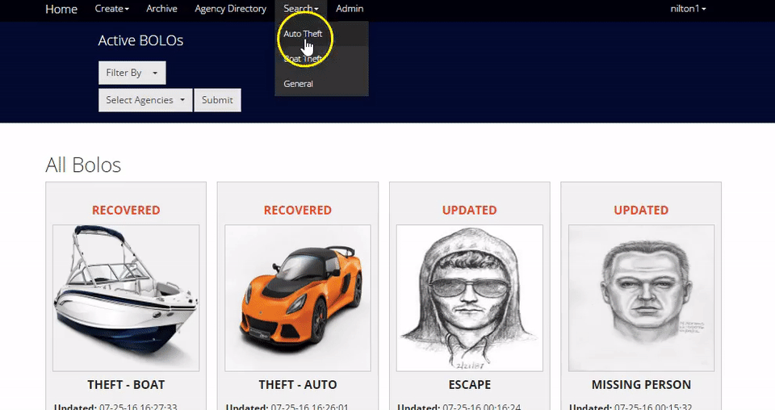

Slide 15
User Story #4: Implement time retrieval points for data analysis for Create Bolo (General - Auto - Boat)
Create two new fields, and add them as attributes in Bolo.js
Create a JQuery validation to check in real time those two fields and enable or disable the submit button
Notes:
20 seconds
The tile of user story
Please present and show the complexity of your work, code, algorithms, and technical challenges and technologies you have used. (you could use screenshot if you want. Visual presentations are better than text presentation) - Go into the details of the most important/significant tasks using bullet lists or visual graphs or state chart diagram - Demo using screenshots or GIF (in another separate page if required)
Sequence Diagram for this user story is optional

Slide 16
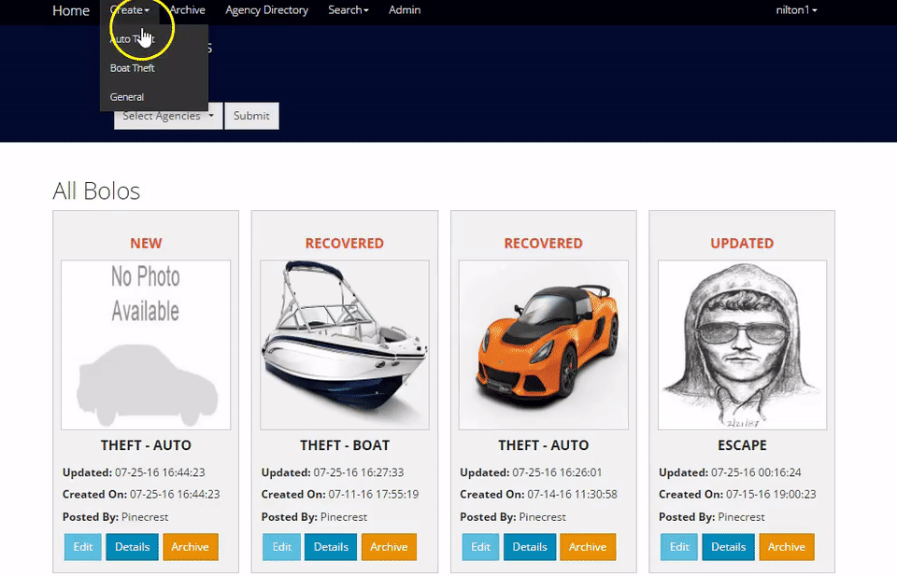

Slide 17
User Story #5: Implement time retrieval points for data analysis for Edit Bolo (General - Auto - Boat)
Create Five new fields, and add them as atributtes in Bolo.js
Show the time retrieval points if the status changes
Create a JQuery validation to check in real time those four fields (one not required) and enable or disable the publish button
Notes:
20 seconds
The tile of user story
Please present and show the complexity of your work, code, algorithms, and technical challenges and technologies you have used. (you could use screenshot if you want. Visual presentations are better than text presentation) - Go into the details of the most important/significant tasks using bullet lists or visual graphs or state chart diagram - Demo using screenshots or GIF (in another separate page if required)
Sequence Diagram for this user story is optional

Slide 18
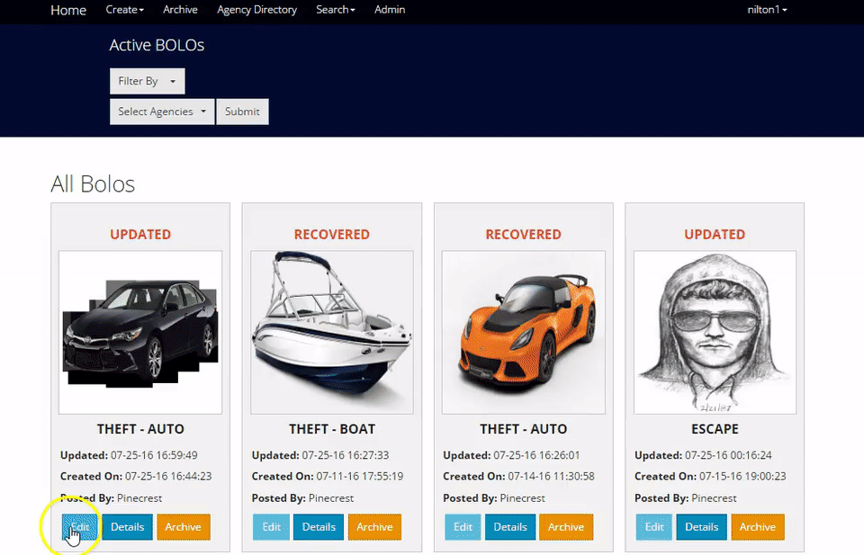

Slide 19
User Story #6: Deactivate and Activate User Accounts from Root and Administrator
Show as disabled only if the user is deactivated
Create new route, service
Access the database to update the new data
Notes:
4. Requirements:
4.1. User stories implemented (one or more slides).
4.2. UML use cases and the use case diagram for the implemented use cases (one or more slides).
4.3. UML sequence diagrams for the implemented use cases.

Slide 20
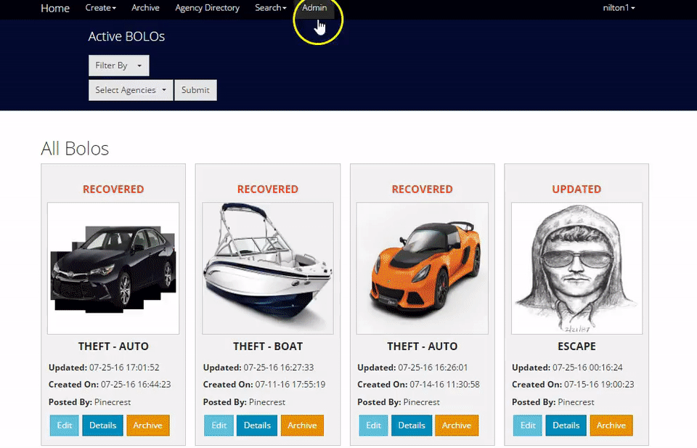

Slide 21
User Story #7: Other Features
Change interactive menu to static
Keep data fields content after validations
Specific views only for root and administrator and a different view for user
View Bolo when it is archived
Notes:
4. Requirements:
4.1. User stories implemented (one or more slides).
4.2. UML use cases and the use case diagram for the implemented use cases (one or more slides).
4.3. UML sequence diagrams for the implemented use cases.

Slide 22


Slide 23
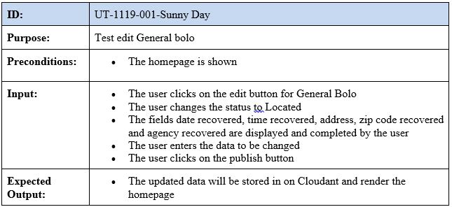
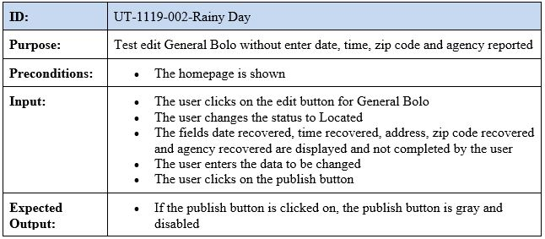
Test Suites and Test Cases
Notes:
10 seconds
A description of verification process and Test Suites and Test Cases for one of the use cases.
1 One sunny day and one rainy day for the implemented use cases (one or more slides).
2 Automated test scripts for the implemented use cases (if any) (one or more slides).

Slide 24
Summary
Worked on the creation of new templates for Bolo Theft Auto - Bolo Theft Boat (Edit, Preview, View, PDF), new routes, services. Search pages and index. Time retrieval points for Data Analysis. User management options.
contact information
Nilton Munoz
(954) 773-6704
https://www.linkedin.com/in/nilton-muñoz-a71707a
nmuno013@fiu.edu
Notes:
10 seconds
Summarize your contribution, mention your effort for Scrum, Mingle, Github, Google Drive Documentation and minutes
Include your contact information
Ask if anyone has any questions for you.
Thank your audience

Slide 25









Thank You! Questions?

